Slide 1
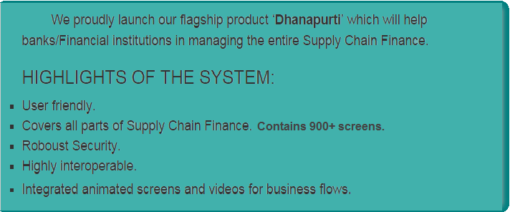
Dhanapurti
Annona IT Solutions Pvt Ltd

Slide 2
Technical Aspects
TECHNICAL ASPECTS

Slide 3
Environment
Frameworks - Spring 3.1, JPA 2, JQuery, JavaScript, JSP
Eclipse IDE ,Tomcat 8.0, JDK 7.0
Database - PostgreSQL

Slide 4
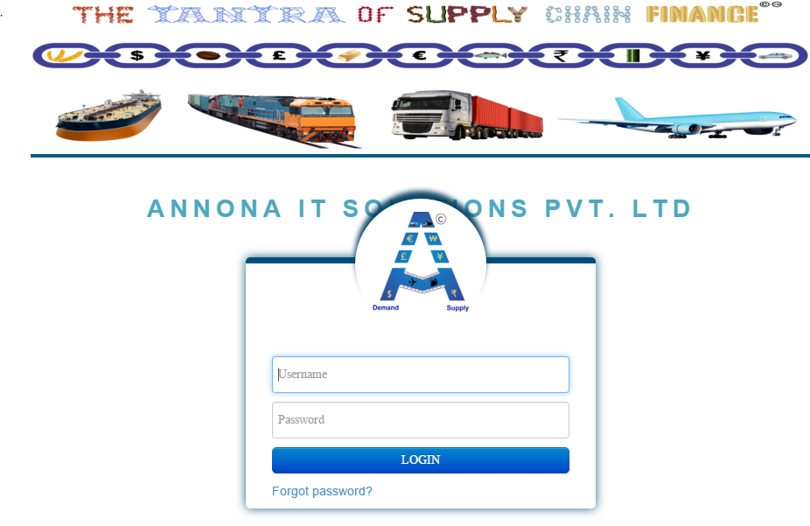
Role Based Screens

Slide 5
Localization and Internalization
Supports 16 major Languages
English
Hindi
Spanish
German
French
Italian
Arabic
Portuguese
Chinese
Japanese
Russian
Bulgarian
Hungarian
Czech
Ukrainian
Croatian

Slide 6
User based Themes

Slide 7
Automatic Email Notifications
Email

Slide 8
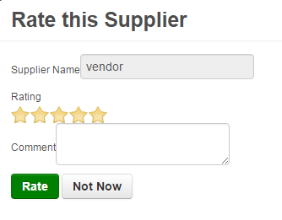
Dynamic Rating System

Slide 9
Configurable Database
<properties>
<property name="javax.persistence.jdbc.url" value="jdbc:postgresql://localhost:5432/postgres" />
<property name="javax.persistence.jdbc.driver" value="org.postgresql.Driver" />
<property name="javax.persistence.jdbc.user" value="postgres" />
<property name="javax.persistence.jdbc.password" value="1234" />
<property name="hibernate.dialect" value="org.hibernate.dialect.PostgreSQLDialect" />
<property name="hibernate.hbm2ddl.auto" value="update" />

Slide 10
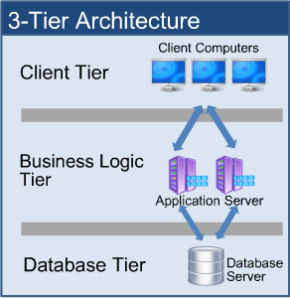
3 Tier Architecture

Slide 11
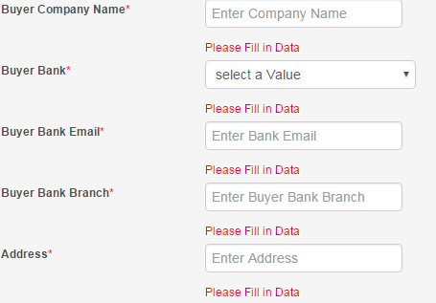
Validations Framework

Slide 12
Other Features
Spring Security on URL and login Password
Session Handling with flexible login-logout time
JSP connected to tiles
Common Headers and footers for all JSP
High performance
Highly Interoperable
Can be operated without internet connection
Flexible with multiple users

Slide 13
Functional Aspects
FUNCTIONAL ASPECTS

Slide 14
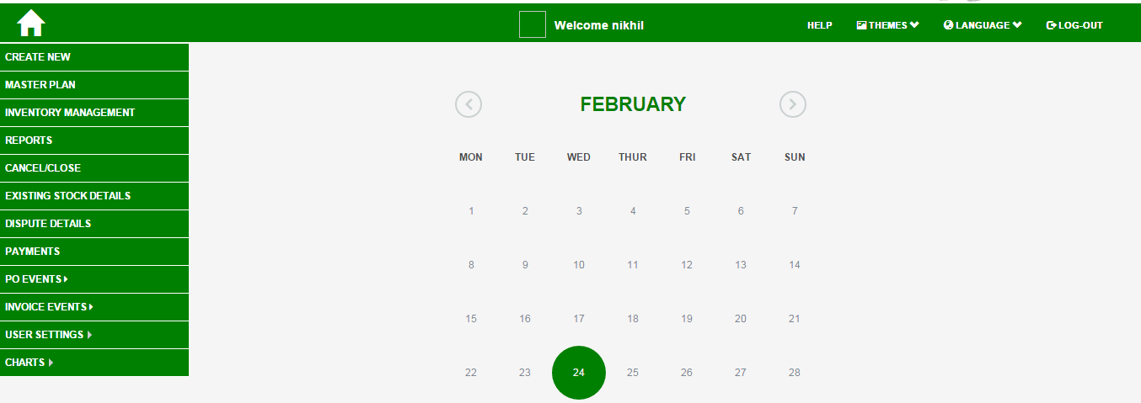
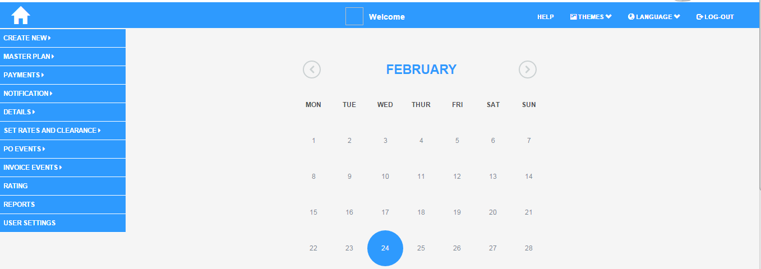
User Defined Accounts
Customer
Bank Employee
System consists of 11 types of accounts

Slide 15
Two Level Approval System
Customer
Customer Approval Manager
Bank

Slide 16
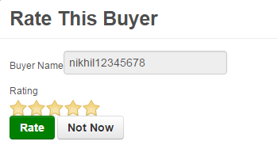
Rating for Buyers & Suppliers

Slide 17
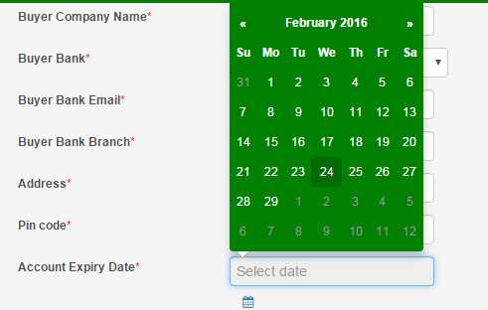
Account Expiry System
On Account Expiry User gets email intimation 2 days prior regarding the same

Slide 18
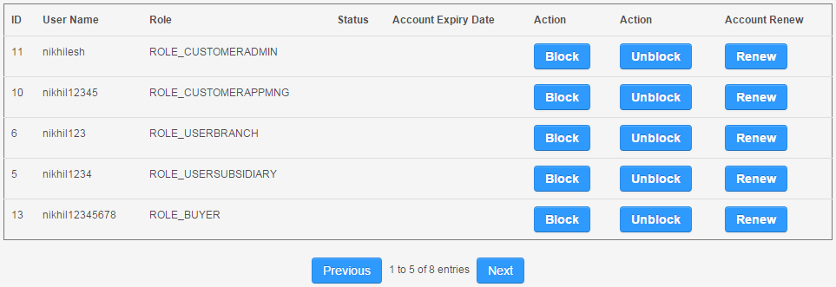
Block/Unblock Account

Slide 19
Swap/Revert Accounts
Admin can swap account to other user and revert to original user flexibly

Slide 20
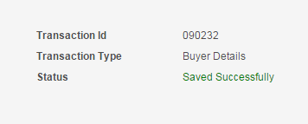
Unique ID
Unique ID is generated by System for every transaction

Slide 21
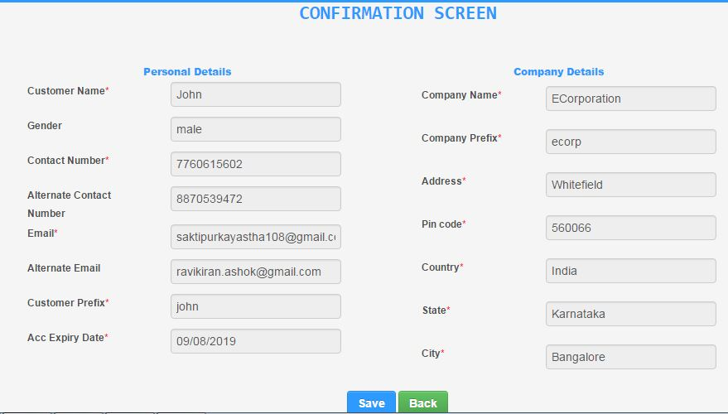
Confirmation Screens

Slide 22
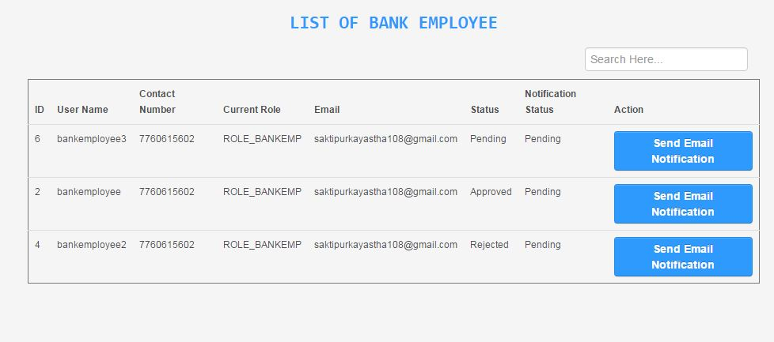
Email Notifications

Slide 23
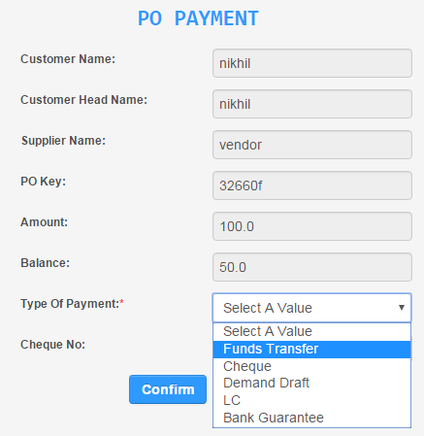
Payment System
End to End Payment system with Multiple & Advance payment options. Cash payment
can also be monitored

Slide 24
Animation
Fully dynamic animated videos
For Animation videos please check out the link below: - https://youtu.be/l2s2fhMD99Q

Slide 25
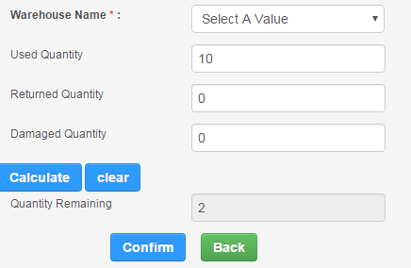
Inventory Management
Inventory management capturing dynamic goods statistics

Slide 26
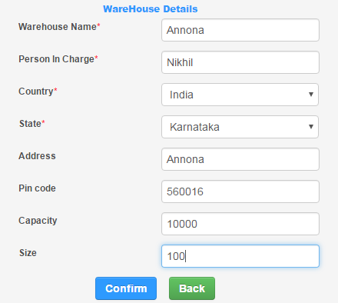
Warehouse Management

Slide 27
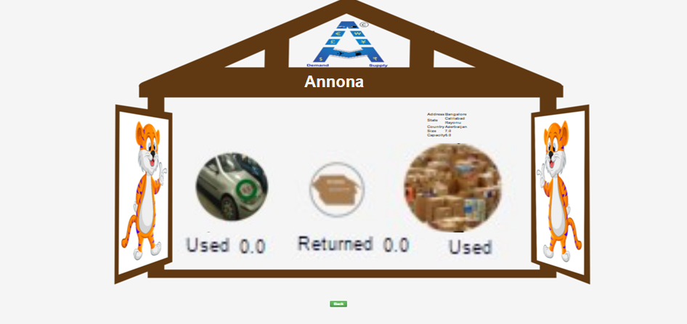
Warehouse Design

Slide 28
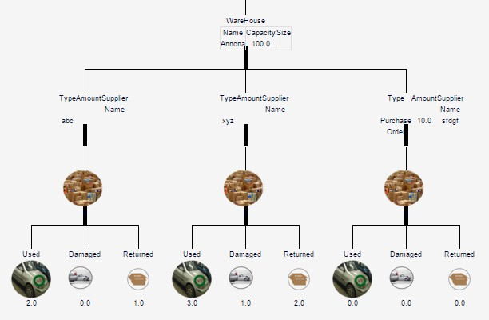
Tree Structure
Dynamic tree structure for warehouse and inventory details with images

Slide 29
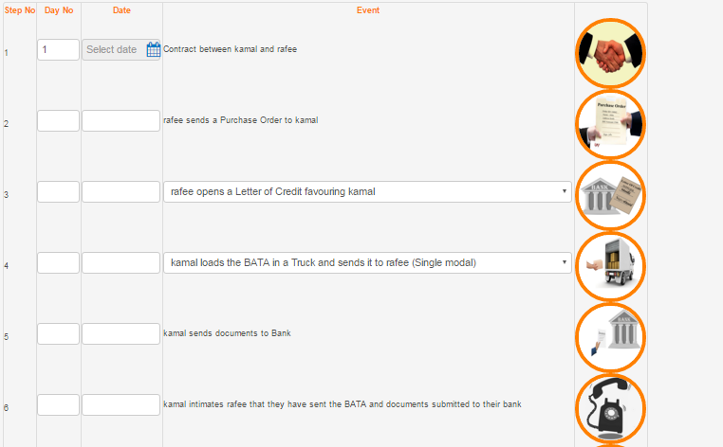
Planning Tool

Slide 30
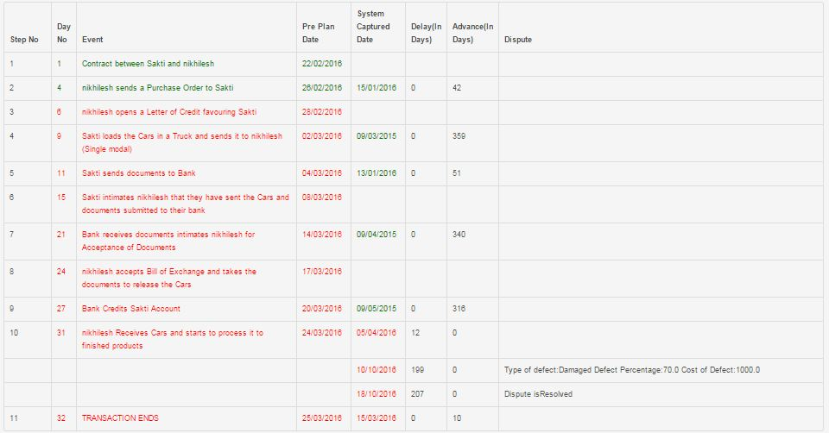
Comparison Tool

Slide 31
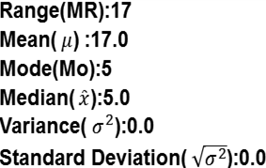
Reporting Tool
Fully flexible report system with automatically generated statistical data with Download and Print option

Slide 32
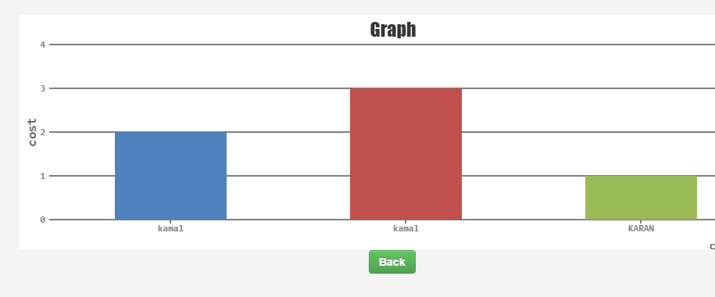
Graphs
Graphical view of Cost exposure

Slide 33
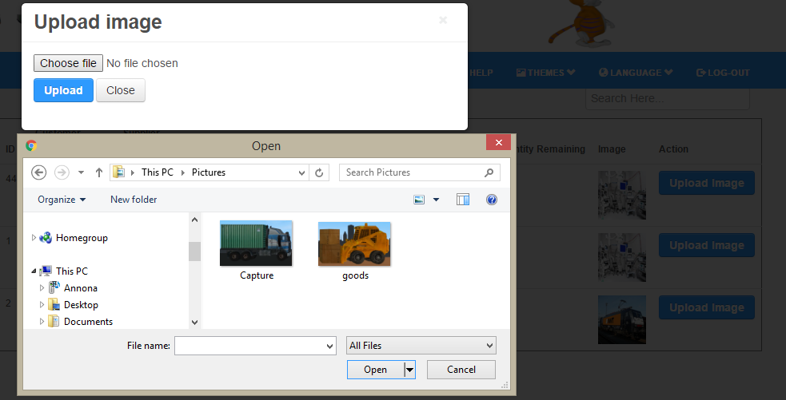
Images & Files Upload

Slide 34
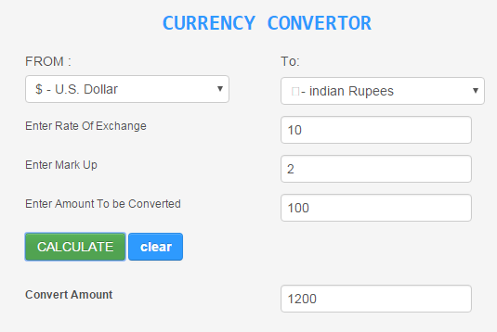
Currency Convertor
Multiple Currencies conversion and calculations

Slide 35
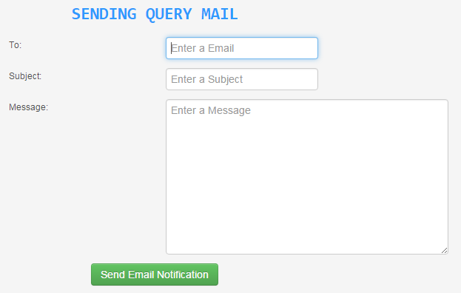
Query Emails

Slide 36
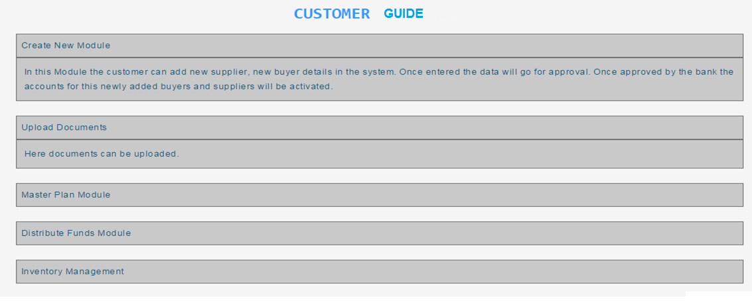
Help Guide
Guide for every Role

Slide 37
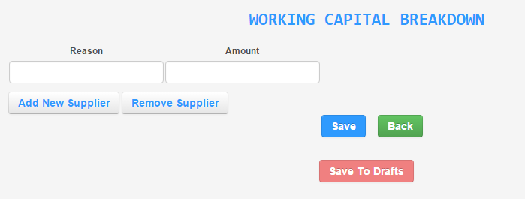
Drafts Option

Slide 38
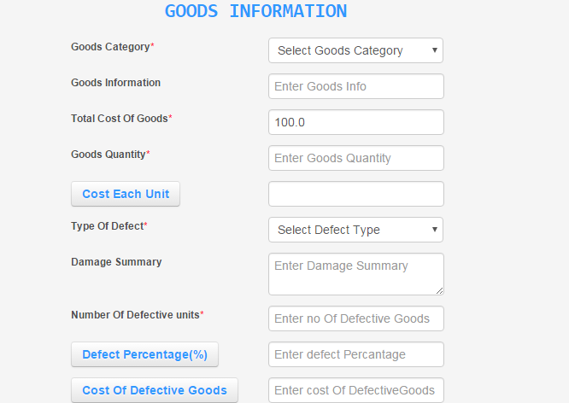
Disputes on Goods

Slide 39
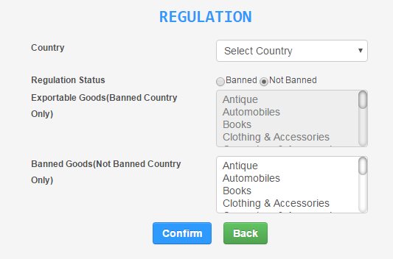
Regulations
Regulations on Countries and Goods

Slide 40
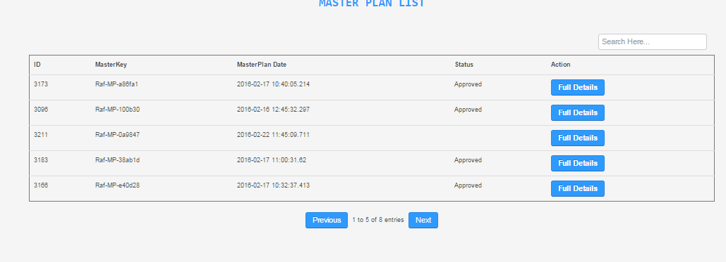
Grids Functionality
Search & Pagination

Slide 41
Common Screens
Two different accounts section with Notifications

Slide 42
Other Features
Flexible Automatic email on payments
Transfer Pricing Monitoring
Detailed records for all relevant data
Password Expiry & Forgot Password
We have applied patent for the product

Slide 43
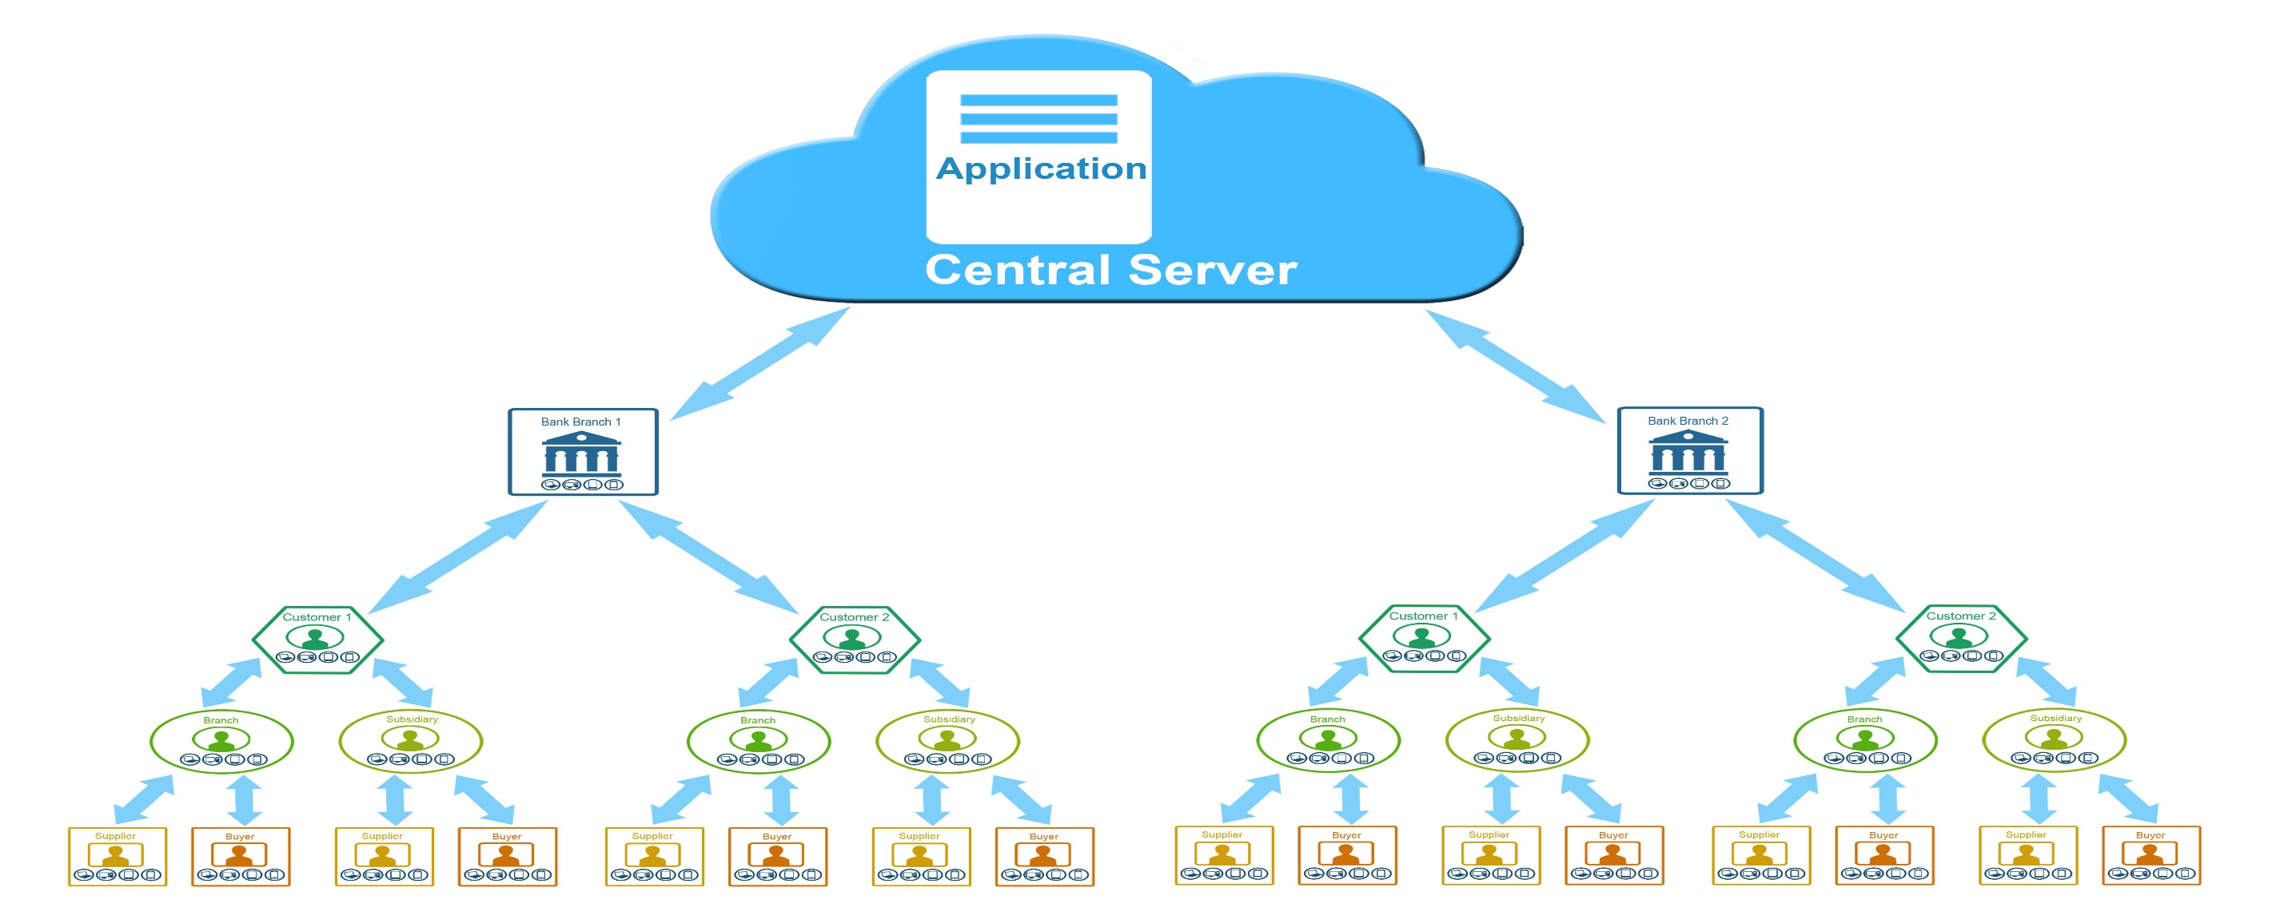
Cloud Services

Slide 44
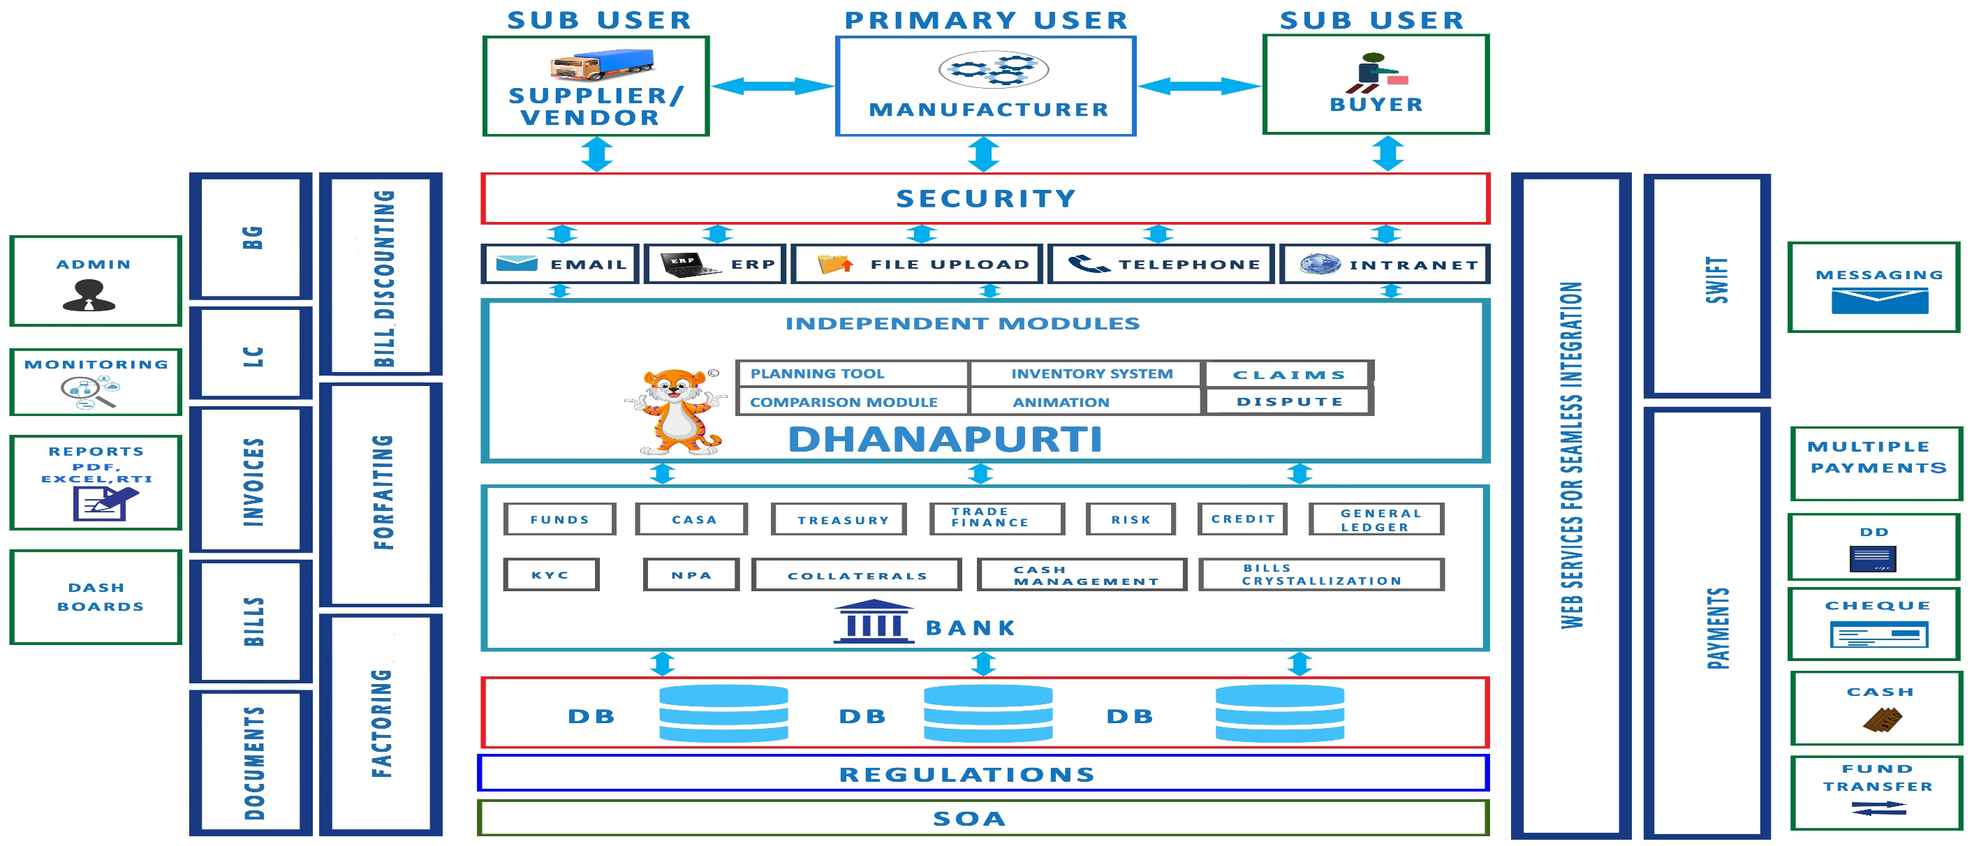
High Level Architecture

Slide 45
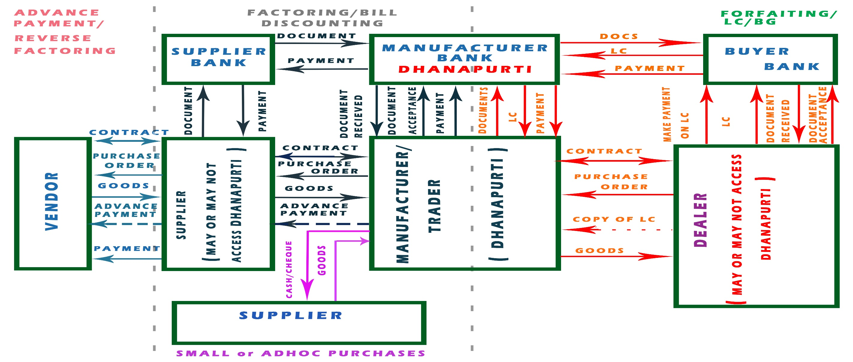
Process Flow

Slide 46
Thank You

